Slide 1
Designing and Analysis of Algorithms Course Code: ECS 5101/CS514
Dr Rahul Mishra
IIT Patna
Lecture 19

Slide 2
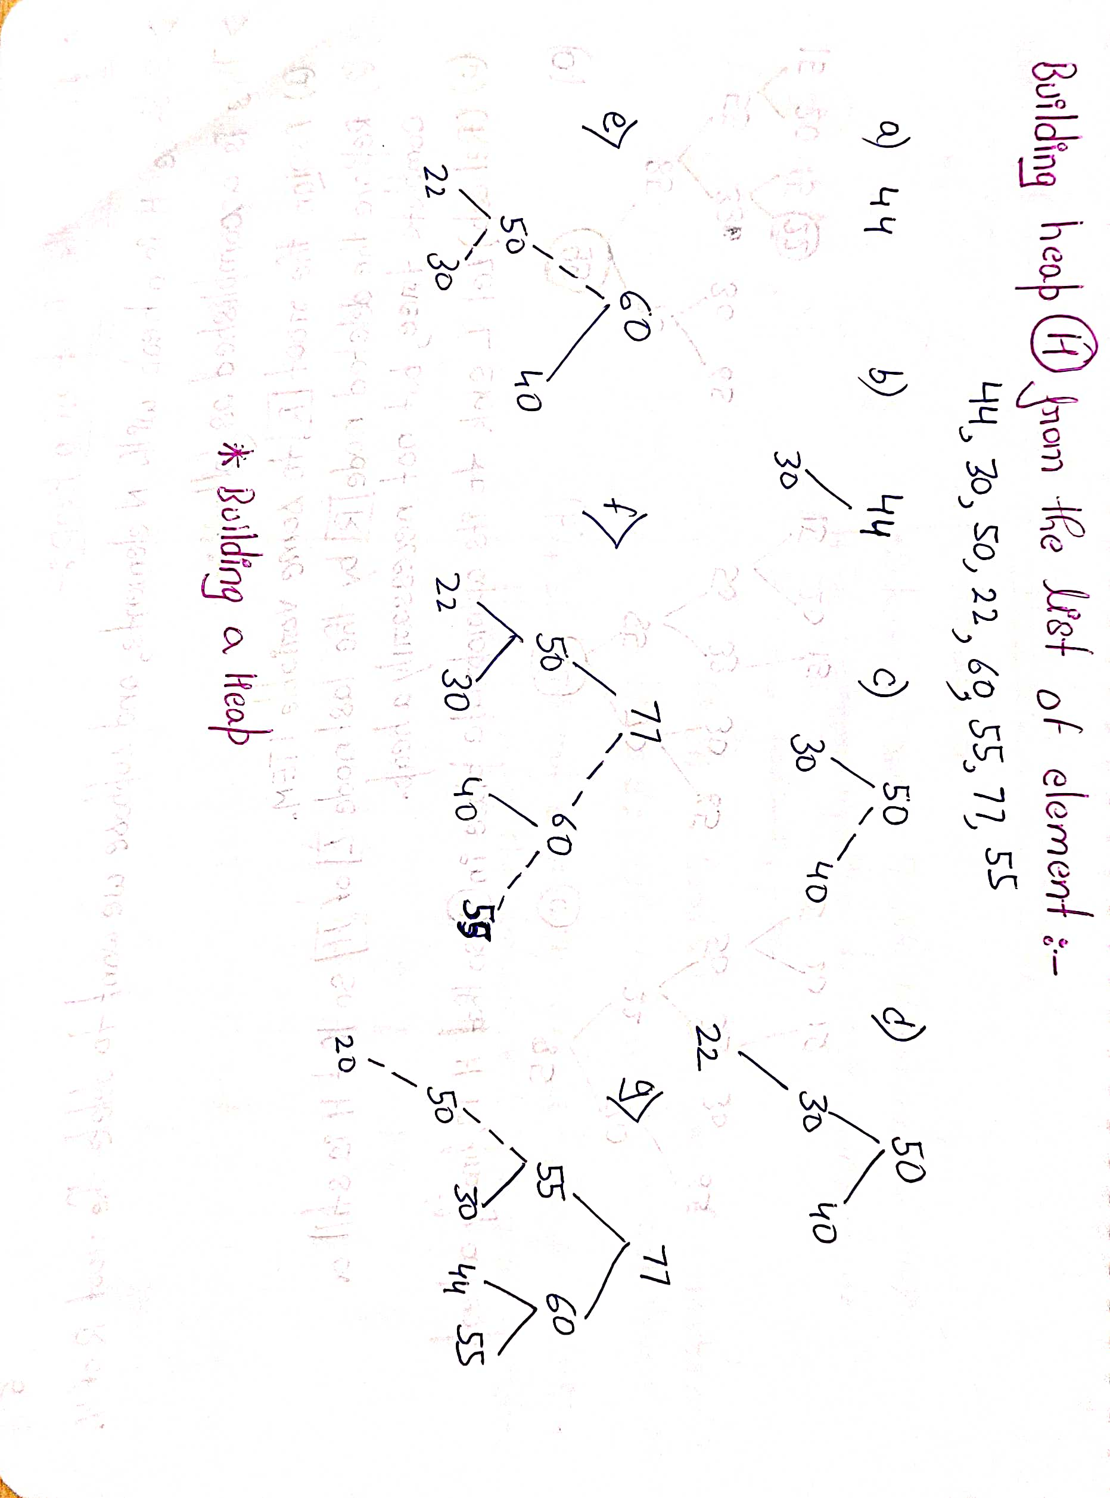
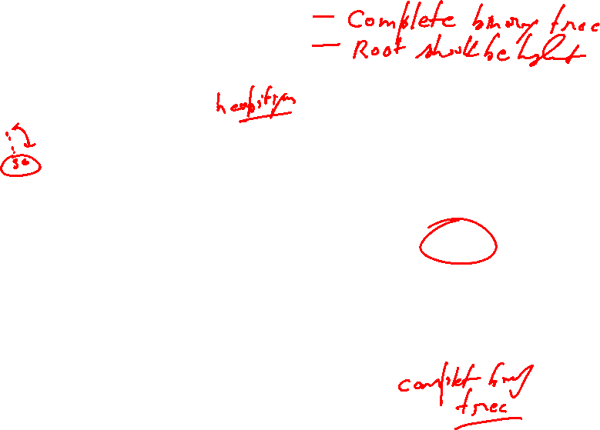

Slide 3
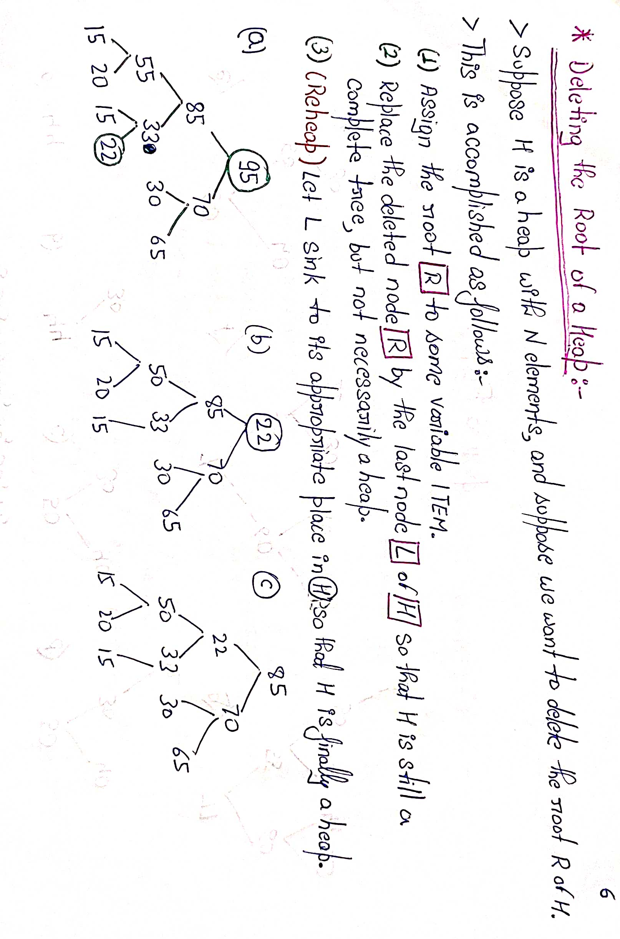



Slide 4
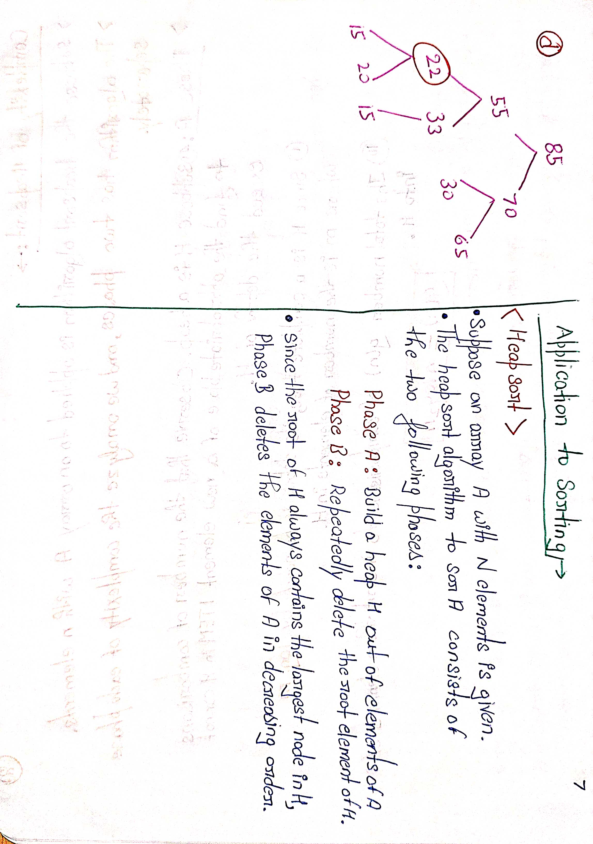
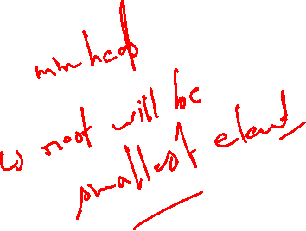

Slide 5
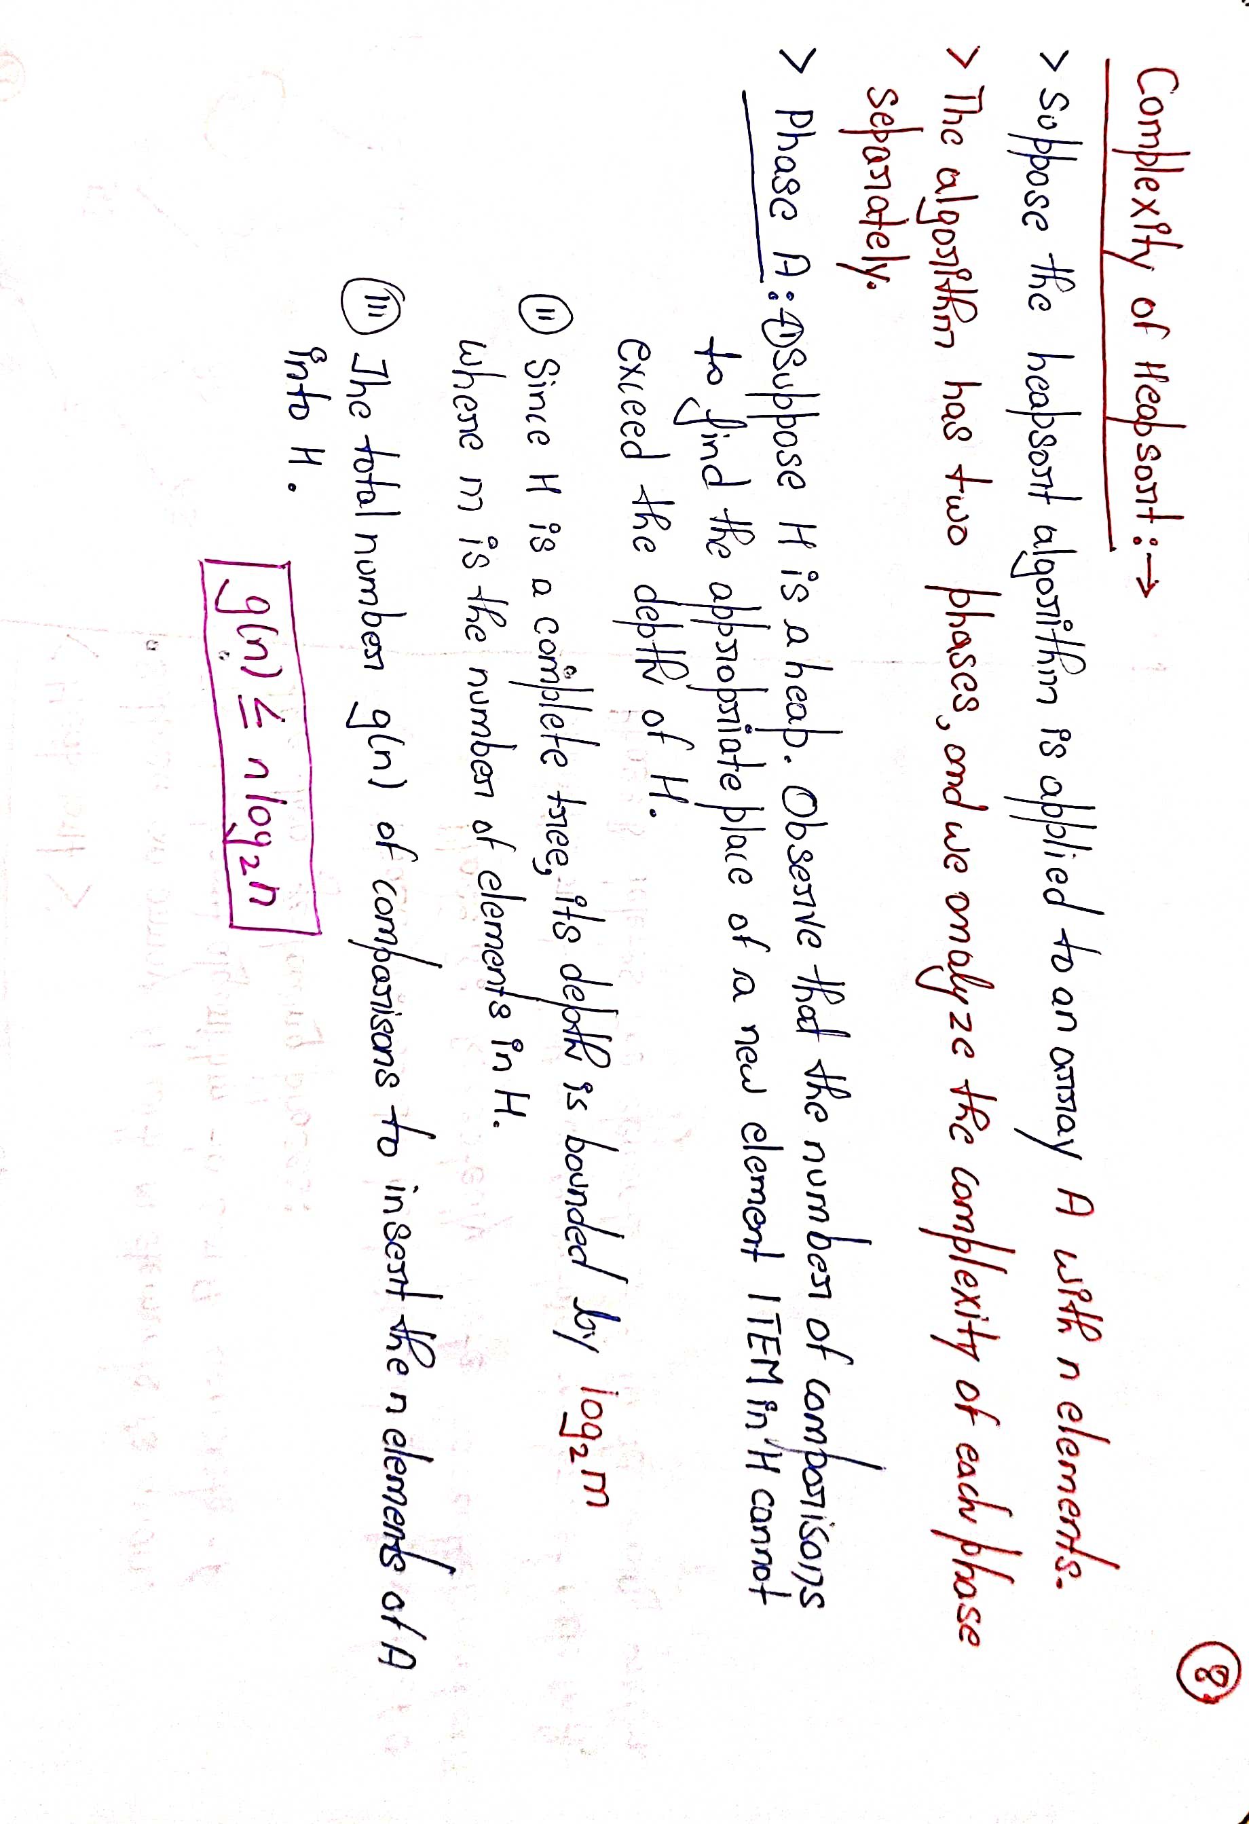

Slide 6
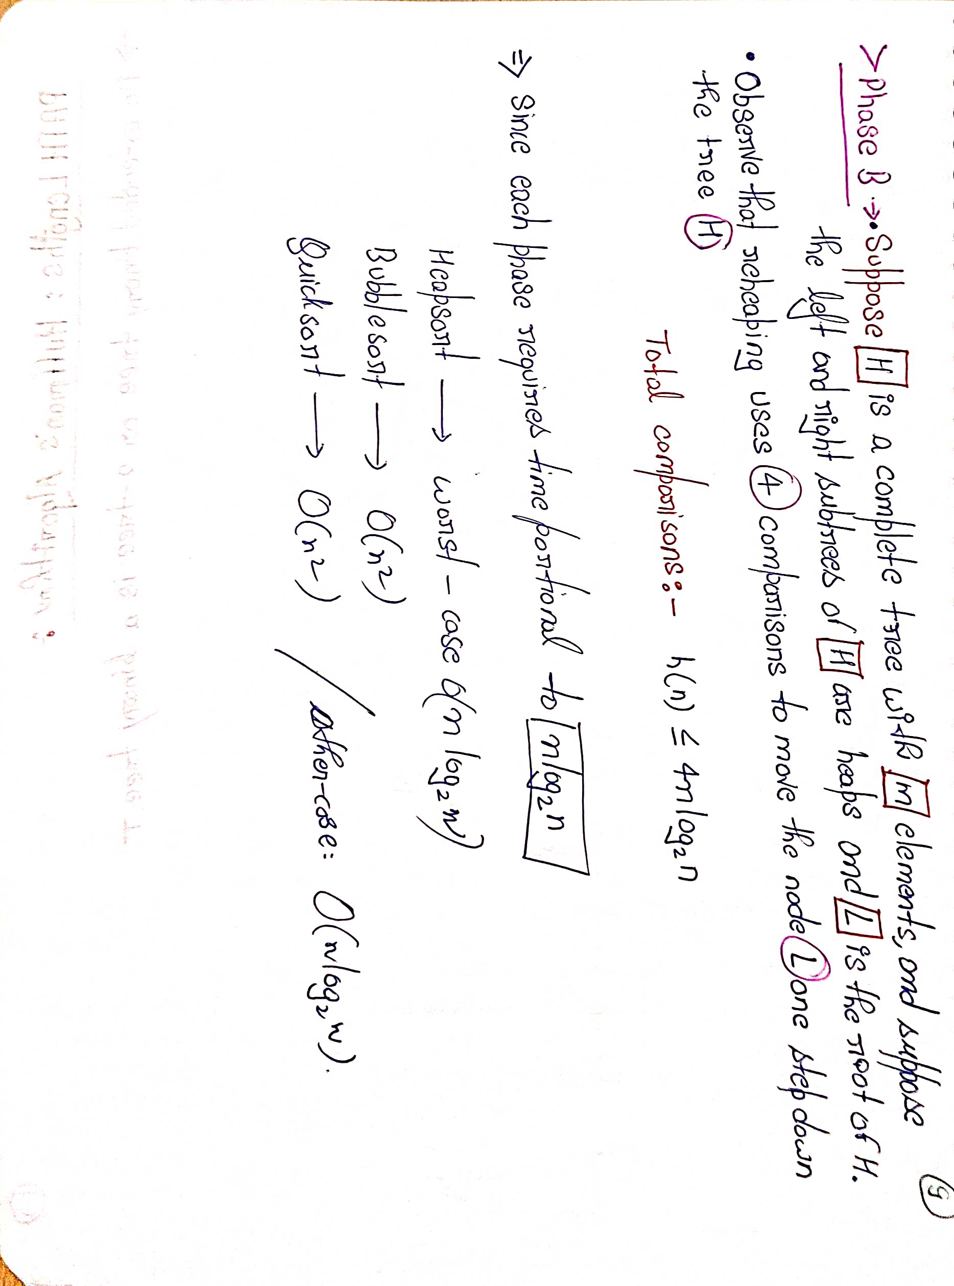

Slide 7
A forest is an undirected graph in which any two vertices are connected by at most one path.
Equivalently, a forest is an undirected acyclic graph, all of whose connected components are trees; in other words, the graph consists of a disjoint union of trees.
As special cases, the order-zero graph (a forest consisting of zero trees), a single tree, and an edgeless graph, are examples of forests.
Since for every tree V − E = 1, we can easily count the number of trees that are within a forest by subtracting the difference between total vertices and total edges. TV − TE = number of trees in a forest.

Slide 8
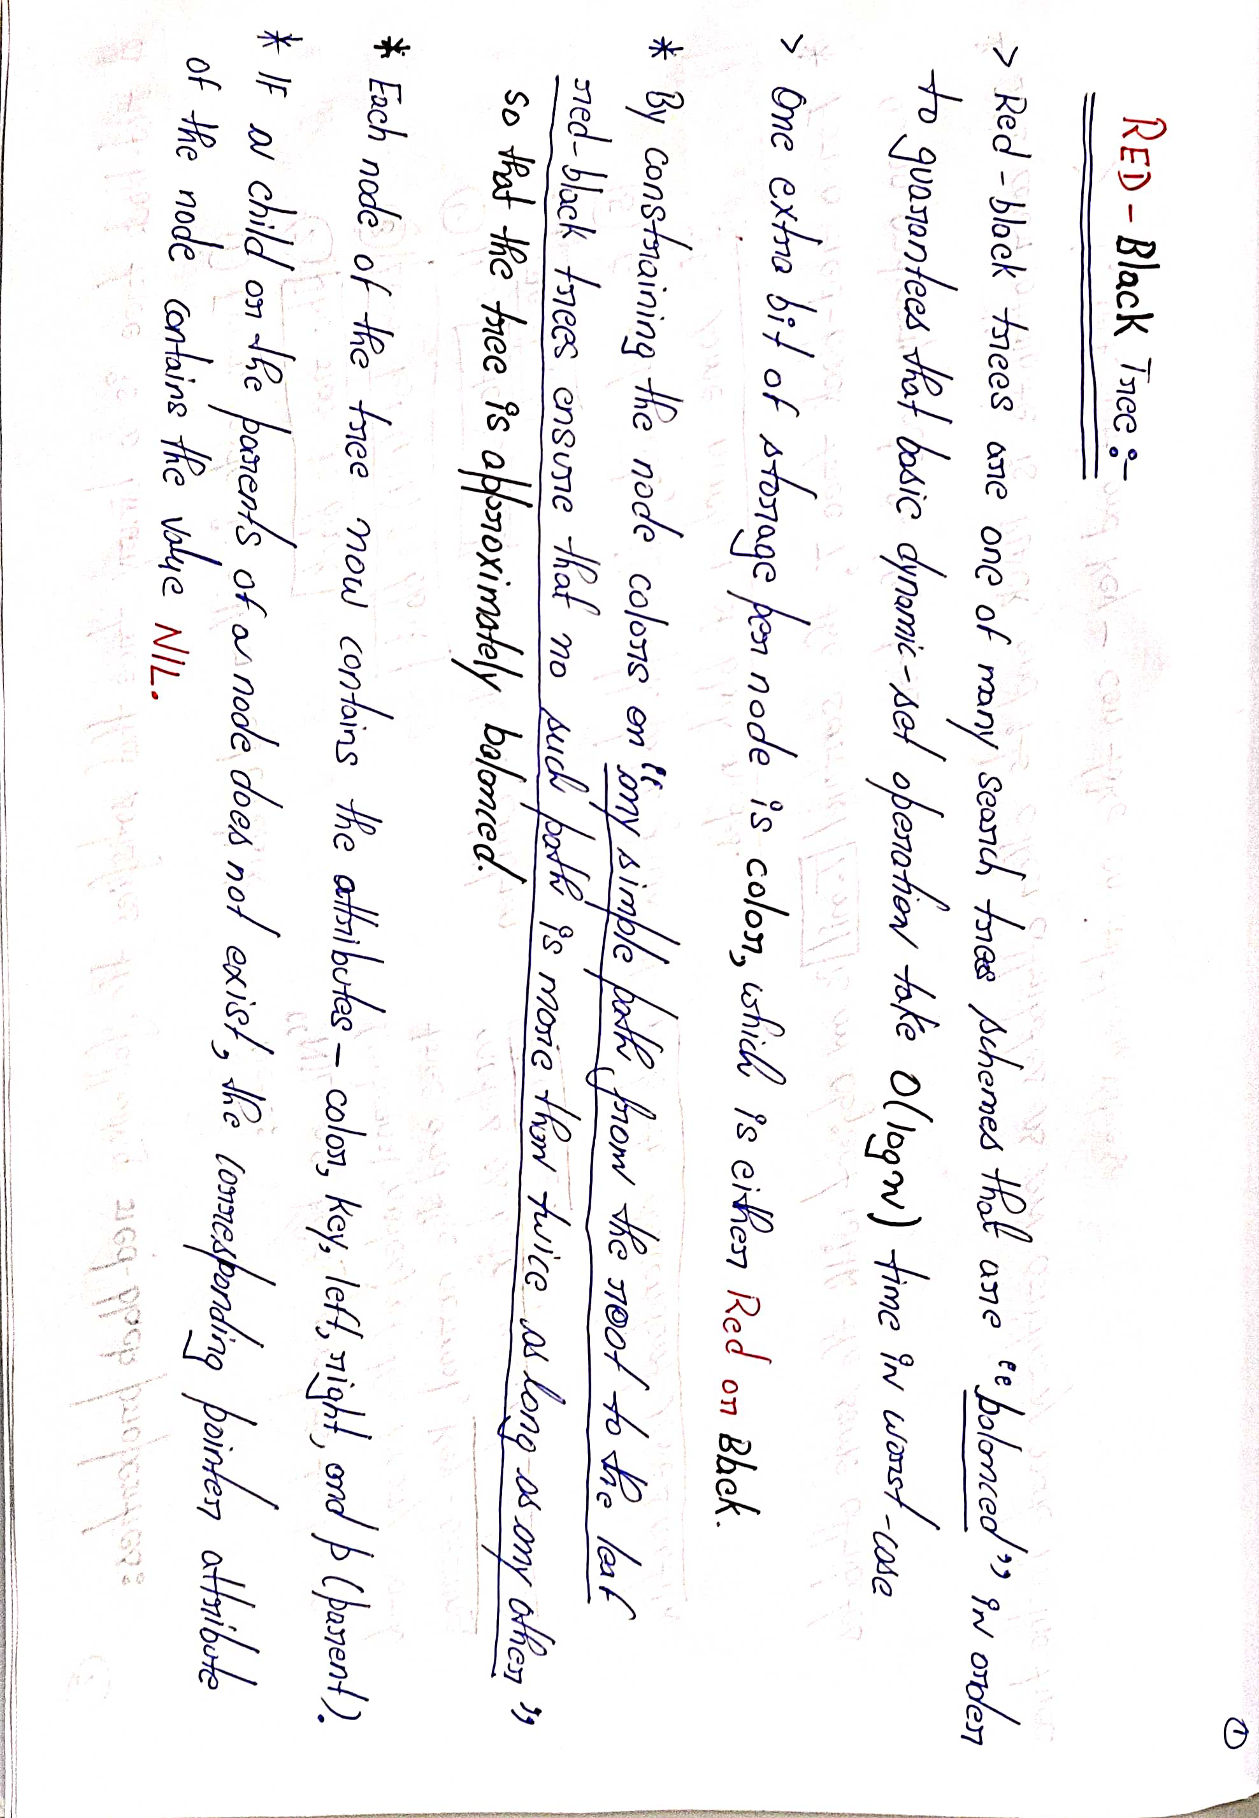

Slide 11
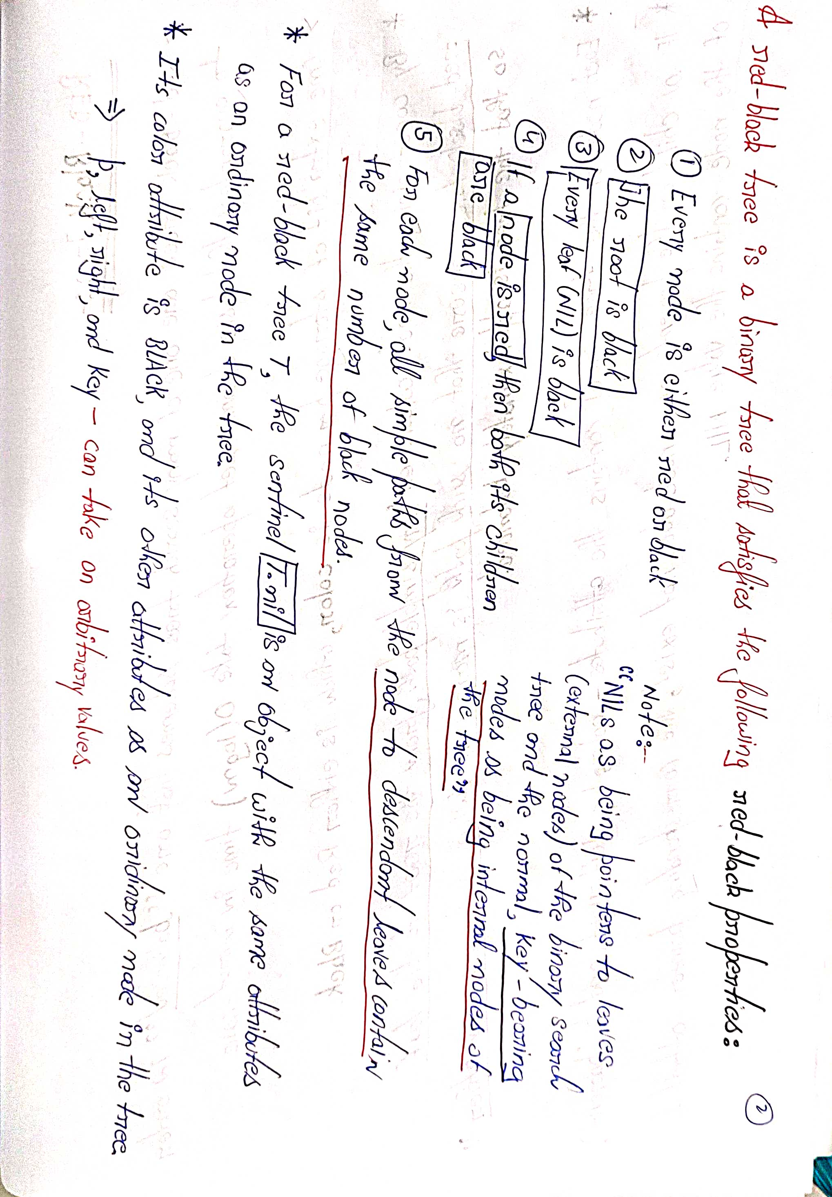

Slide 12
